Slide 1




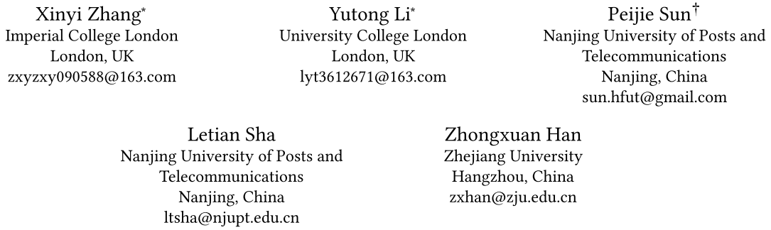





ATAI
Advanced Technique of Artificial Intelligence
ATAI
ChongqingUniversity _{AdvancedTechniqueof}
of Technology Artificial Intelligence
Chongqing University of Technology
Chongqing University ^{ATAI}
_{of Technology} Advanced Techniqueof
Artificial Intelligence
Chongqing University of Technology
Chongqing University of Technology
PRISM: Personalized Recommendation via Information Synergy Module
code: https://github.com/YutongLi2024/PRISM
—— WWW ’26
Reported by Junsi Chen
1

Slide 2

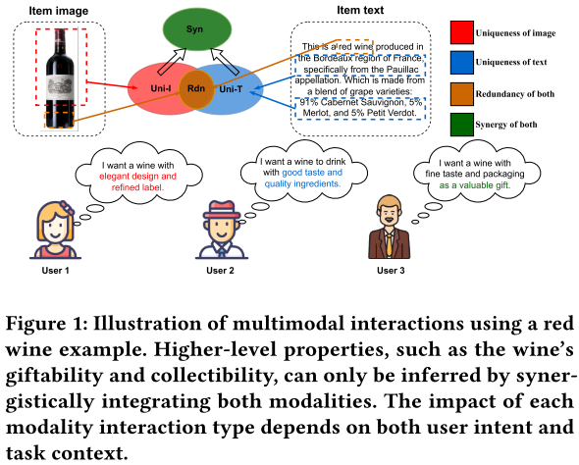
ATAI
AdvancedTechniqueof
Artificial Intelligence
ATAI
ChongqingUniversity _{AdvancedTechniqueof}
of Technology Artificial Intelligence
ChongqingUniversity of Technology
Motivation
(1) Existing methods fail to capture synergistic information that emerges only from the combination of modalities due to the lack of systematic modeling of multimodal interactions.
(2) Existing methods typically assume that the relative importance of modality interactions remains consistent across all users and recommendation scenarios, thereby overlooking user-specific preferences in utilizing multimodal information.

Slide 3

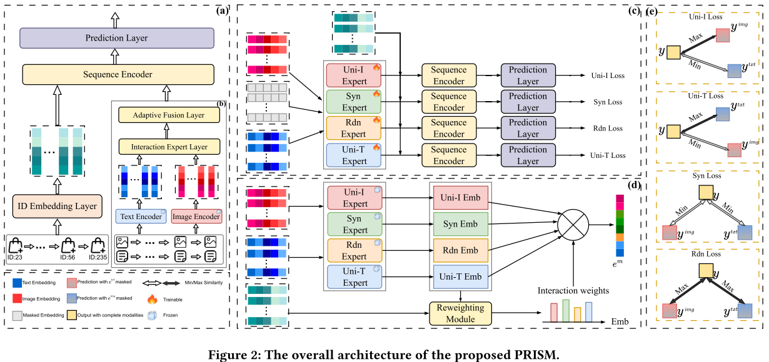
ChongqingUniversity of Technology
ATAI
AdvancedTechniqueof
Artificial Intelligence
ATAI
ChongqingUniversity _{AdvancedTechniqueof}
of Technology Artificial Intelligence
Overview

Slide 4
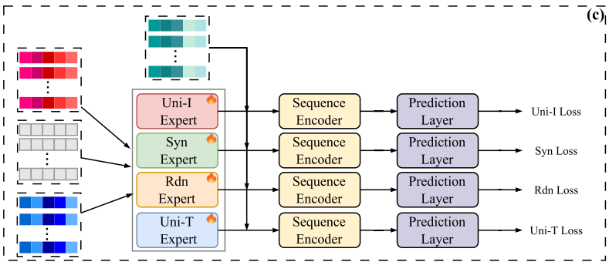
ChongqingUniversity of Technology
ATAI
AdvancedTechniqueof
Artificial Intelligence
ATAI
ChongqingUniversity _{AdvancedTechniqueof}
of Technology Artificial Intelligence
Method
(1)
(2)
(3)
(4)

Slide 5
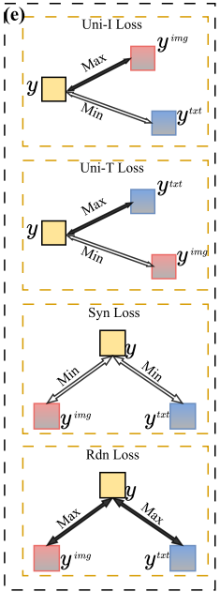






ChongqingUniversity of Technology
ATAI
AdvancedTechniqueof
Artificial Intelligence
ATAI
ChongqingUniversity _{AdvancedTechniqueof}
of Technology Artificial Intelligence
Method
(5)
(6)
(7)
(8)
(9)
(10)
(11)
(12)

Slide 6

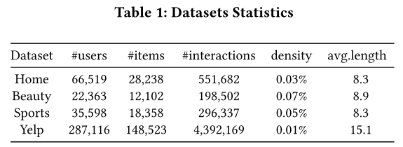
ATAI
Advanced Technique of Artificial Intelligence
ATAI
ChongqingUniversity _{AdvancedTechniqueof}
of Technology Artificial Intelligence
Chongqing University of
Technology
Chongqing University ^{ATAI}
_{of Technology} Advanced Techniqueof
Artificial Intelligence
Chongqing University of Technology
Chongqing University of Technology

Slide 7
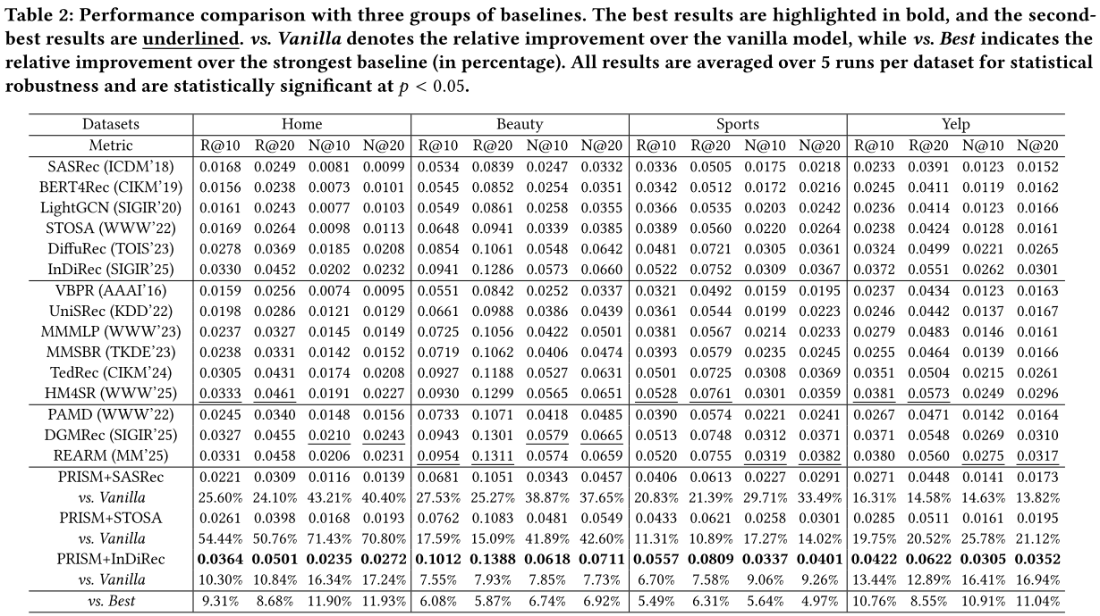
ATAI
Advanced Technique of Artificial Intelligence
ATAI
ChongqingUniversity _{AdvancedTechniqueof}
of Technology Artificial Intelligence
Chongqing University of
Technology
Chongqing University ^{ATAI}
_{of Technology} Advanced Techniqueof
Artificial Intelligence
Chongqing University of Technology
Chongqing University of Technology

Slide 8
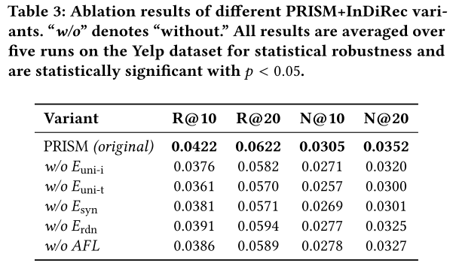
ATAI
Advanced Technique of Artificial Intelligence
ATAI
ChongqingUniversity _{AdvancedTechniqueof}
of Technology Artificial Intelligence
Chongqing University of
Technology
Chongqing University ^{ATAI}
_{of Technology} Advanced Techniqueof
Artificial Intelligence
Chongqing University of Technology
Chongqing University of Technology

Slide 9
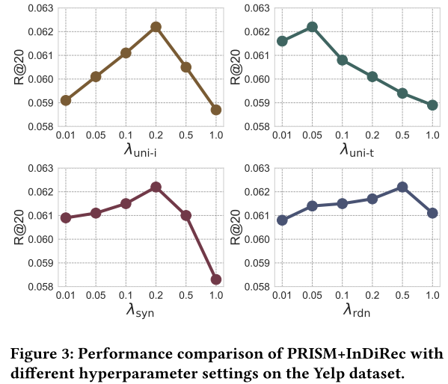
ATAI
Advanced Technique of Artificial Intelligence
ATAI
ChongqingUniversity _{AdvancedTechniqueof}
of Technology Artificial Intelligence
Chongqing University of
Technology
Chongqing University ^{ATAI}
_{of Technology} Advanced Techniqueof
Artificial Intelligence
Chongqing University of Technology
Chongqing University of Technology

Slide 10
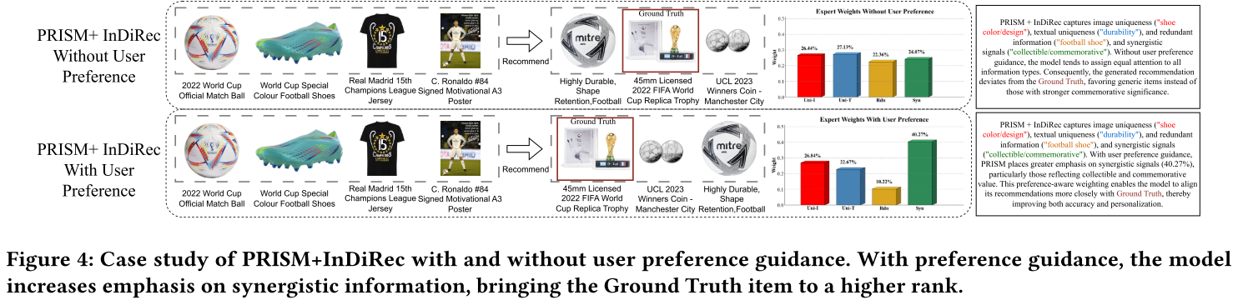
ATAI
Advanced Technique of Artificial Intelligence
ATAI
ChongqingUniversity _{AdvancedTechniqueof}
of Technology Artificial Intelligence
Chongqing University of
Technology
Chongqing University ^{ATAI}
_{of Technology} Advanced Techniqueof
Artificial Intelligence
Chongqing University of Technology
Chongqing University of Technology

Slide 11
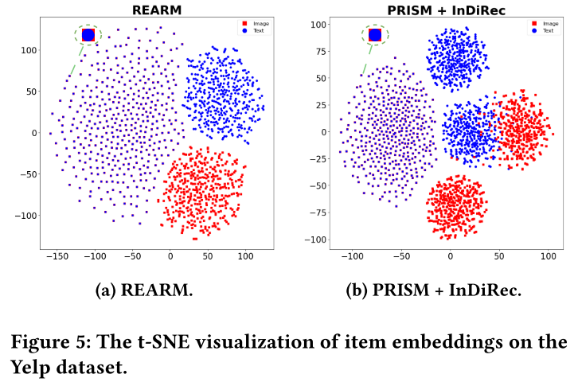
ATAI
Advanced Technique of Artificial Intelligence
ATAI
ChongqingUniversity _{AdvancedTechniqueof}
of Technology Artificial Intelligence
Chongqing University of
Technology
Chongqing University ^{ATAI}
_{of Technology} Advanced Techniqueof
Artificial Intelligence
Chongqing University of Technology
Chongqing University of Technology

Slide 12


ATAI
Advanced Technique of
Artificial Intelligence
ATAI
ChongqingUniversity _{AdvancedTechniqueof}
of Technology Artificial Intelligence
Chongqing University of Technology
Thanks!

